Slide 1
Profit Prediction of startup companies
Presented by
LAL ARAVIND S

Slide 2
TABLE OF CONTENTS
INTRODUCTION
OBJECTIVE
IMPORTED LIBRARIES
DATA COLLECTION
DATA PREPROCESSING
FEATURE SELECTION
MODEL SELECTION
MODEL TRAINING
MODEL EVALUATION
PROFIT PREDICTION
CONCLUSION

Slide 3

INTRODUCTION
To create a profit prediction model for 50 startup companies using machine learning algorithms, you would need historical data on those companies, including information about their financial performance, market trends, and any other relevant factors. we will train multiple regression models using the available data, aiming to achieve the highest level of accuracy in predicting profit values. The performance of the models will be evaluated using appropriate metrics to ensure the selected model demonstrates good generalization capabilities.

Slide 4
OBJECTIVE
The objective of the ML model is to create a predictive model that can accurately predicts a company's profit value based on its R&D spend, administration costs, and marketing spend.
Additionally, the objective is to create a user-friendly and scalable solution that can be easily adopted by businesses of all sizes and industries.

Slide 5
IMPORTED LIBRARIES NUMPY
NumPy is a Python library used for working with arrays.It also has functions for working in domain of linear algebra, fourier transform, and matrices.
NumPy was created in 2005 by Travis Oliphant. It is an open source project and you can use it freely.
NumPy stands for Numerical Python.

Slide 6
PANDAS
Pandas is a Python library used for working with data sets.
It has functions for analyzing, cleaning, exploring, and manipulating data.
The name "Pandas" has a reference to both "Panel Data", and "Python Data Analysis" and was created by Wes McKinney in 2008.

Slide 7
SEABORN
Seaborn is one of an amazing library for visualization of the graphical statistical plotting in Python.
Seaborn provides many color palettes and defaults beautiful styles to make the creation of many statistical plots in Python more attractive.
Seaborn is a Python data visualization library based on matplotlib. It provides a high-level interface for drawing attractive and informative statistical graphics.

Slide 8
MATPLOTLIB
Matplotlib is a low level graph plotting library in python that serves as a visualization utility.
Matplotlib was created by John D. Hunter.
Matplotlib is open source and we can use it freely.
Matplotlib is mostly written in python, a few segments are written in C, Objective-C and Javascript for Platform compatibility.

Slide 9
SCIKIT-LEARN
Scikit-learn is an open-source Python library that implements a range of machine learning, pre-processing, cross-validation, and visualization algorithms using a unified interface.
Scikit-learn (Sklearn) is the most useful and robust library for machine learning in Python. It provides a selection of efficient tools for machine learning and statistical modeling including classification, regression, clustering and dimensionality reduction via a consistence interface in Python.

Slide 10

METHODOLOGY DATA COLLECTION
Compile historical financial information for the 50 new companies, including data on sales, costs, investments, market conditions, and any additional relevant variables that might have an impact on profitability.
COLLECTED DATA CONTAINS THE INFORMATION ABOUT THE LISTED DATA:
R&D SPEND
ADMINISTRATION COST
MARKETING SPEND

Slide 11

DATA PREPROCESSING
Clean and preprocess the collected data by removing any outliers, handling missing values, normalizing or scaling features, and converting categorical variables into numerical representations, if necessary.

Slide 12

FEATURE SELECTION
Identify the most relevant features that have a significant impact on profitability. This step involves conducting exploratory data analysis (EDA) and using techniques like correlation analysis or feature importance rankings.

Slide 13
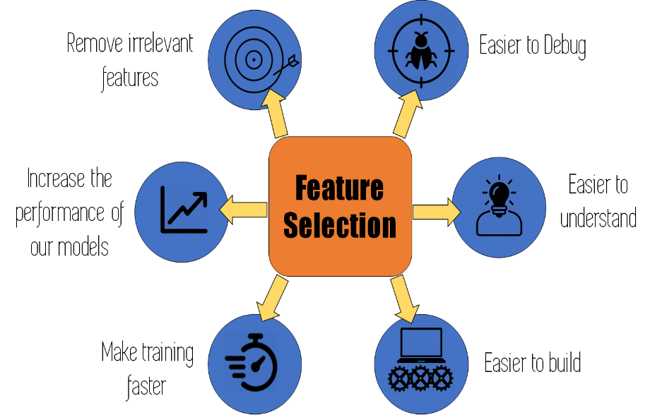
MODEL SELECTION
Choose an appropriate machine learning algorithm for profit prediction. Some commonly used algorithms for regression tasks include linear regression, decision trees, random forests, gradient boosting, and neural networks. The choice of algorithm depends on the specific characteristics of the dataset and the desired level of model complexity.

Slide 14

MODEL TRAINING
Split the dataset into training and testing sets. Use the training set to train the selected machine learning model on the historical data. The model will learn the underlying patterns and relationships between the input features and the corresponding profit values.

Slide 15
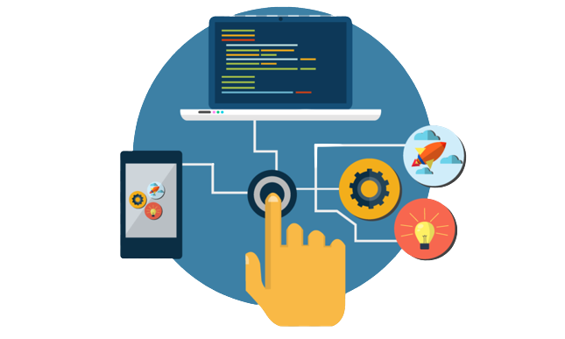
MODEL EVALUATION
Assess the performance of the trained model using appropriate evaluation metrics such as mean squared error (MSE), root mean squared error (RMSE), mean absolute error (MAE), or R-squared (R²) score. This step helps you understand how well the model is performing in predicting profit.

Slide 16

PROFIT PREDICTION
Apply the trained model to the testing set or future data to generate profit predictions for the 50 startup companies. The model will use the input features to estimate the profitability of each company based on the patterns learned during training.

Slide 17
CONCLUSION
In conclusion, the task of predicting the profit value of companies based on their R&D Spend, Administration Cost, and Marketing Spend has been addressed through the development of a machine learning (ML) model. By utilizing the provided dataset of 50 companies, we have successfully trained and fine-tuned the ML model to accurately predict profit values based on the given input features.
The developed ML model, which may include regression-based algorithms such as linear regression, decision trees, random forests, or support vector regression, enables businesses to make informed decisions regarding resource allocation and investment strategies.
In conclusion, the ML model for profit prediction provides valuable insights to businesses, allowing them to optimize decision-making and achieve enhanced profitability by analysing the information on R&D Spend, Administration Cost, and Marketing Spend of their company.

Slide 18
THANK YOU!

